Slide 1
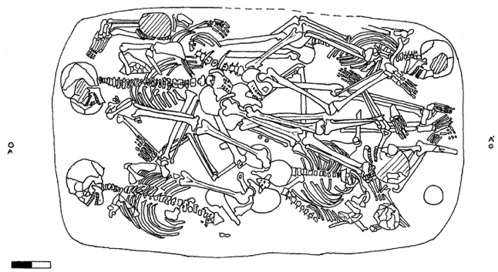
CoRA Product Testing
9th Level Counter Spell IA Capstone - Milestone 3
Nikko Nibres, Jacob Miranda, Nathan Dobesh, Michael Sullivan, Al Salt Al Kharusi

Slide 2
Project Methodology
Test environment familiarization
CoRA Web Application researched
Use case list completed
Developed automated test scripts
Documented scripts

Slide 3
Milestone 3 Accomplishments
Team learned a lot about:
The Dusk test environment
PHP testing
Testing with selectors for certain pages
56 test scripts completed for different user types
Test script code is documented for future ease of use
Bugs and defects found, reported to our client

Slide 4
Demo!

Slide 5
Risks
Original Risk list | Risks as the project progressed
Requirements fail to align with system Learning curve leads to delay Under-Communication System outages Utilizing Penetration testing tools | Learning curve leading to delays Under-communication System outages Web application Our test environments

Slide 6
Conclusions
Largest challenge
Learning curve
Original project goals were met
Compiled a list of detailed use cases for the application
We developed a number of documented, reusable test scripts
Reported our findings to the client and his team, who fixed issues

